Slide 1

Code Refactoring and Bug Fixing
Talla Bhavani
28th February 2024

Slide 2
About me
I am a responsible , results - driven professional completed post graduation in Business Analytics. Being in the stream, i want to learn more skills demanded to be a good business analyst. As part of my research i found Data Analytics and Data Science are current trends in the industry and passionate to gain more knowledge & skills for the role. It is an opportunity to analyse a large set of data, visualize the insights so the organization can make decisions from the insights.
Organised workshops and competitions during Post Graduation, gained experience in team-building and working under pressure.

Slide 3
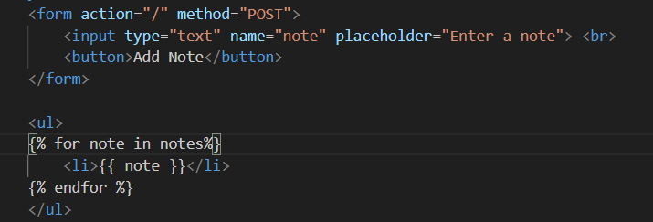
Code Refactoring
Step-1:
In home.html - the action is route “/” and the method is”POST”.
In app.py - @app.route methods are “GET” to read the note which is updated in the ‘Enter a note’ text. And “POST” to create a list of note which is given in the ‘Add a note’ text column.

Slide 4
Bug Fixing
Here the bug is even when the text column is empty the ‘none’ is being adding to the list of the notes below.
To remove the bug we need to follow below code:
Step-1:
If request.method == “POST”:
Here when we fill the ‘Enter a note’ column with a text and click ‘Add note’ then only the note will be updated in the notes list i.e ‘note = request.form.get()’.
Step-2:
If note:
Here it checks that the note is not empty. If it is not empty then it will append to the previous list i.e ‘notes.append(note)’.

Slide 5
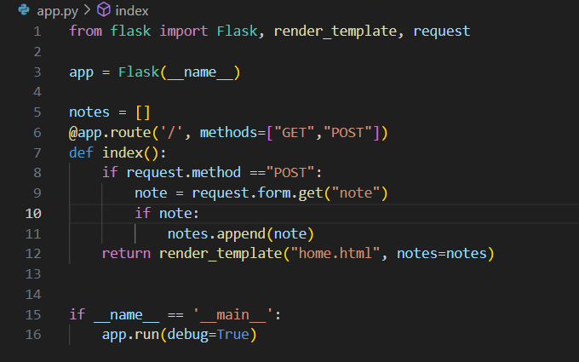

Slide 6

THANK YOU

